Slide 1
Social Marketing:
How Deep can you go?
Michael Myers
michael.myers@du.edu
http://cruc.es

Slide 2
Overview
Findable
Recommendable
Transparent
Collaborative
Social Media vs. Social Business
Questions?

Slide 3
Findable
Build it and they WON’T come!
Inbound marketing – @hubspot
SEM = PPC + SEO
PPC
Search phase list development
Bid management
Ad copy
Campaign adjustments
Michael Myers
michael.myers@du.edu
http://cruc.es

Slide 4
Findable (cont’d)
SEO = Google . . . and Bing + Yahoo!
PageRank *
Keywords *
Metatags
Internal links to your site
Blog posts to product descriptions
Blog posts to other blog posts
Blog posts to site news
Site news to blog posts
Product information to blog post
Incoming Links (Affiliate marketing) *
Michael Myers
michael.myers@du.edu
http://cruc.es

Slide 5
Findable (cont’d)
DAO
Images
“the file name”
the name of the image
the alt tag
Video
“the file name”
transcription
CSS – hide/unhide
<img src=“../ducati-sport-1000.png” name=“Ducati Sport 1000” alt=“Ducati Sport 1000”>
Michael Myers
michael.myers@du.edu
http://cruc.es

Slide 6
Findable (cont’d)
Content - “a site is a living breathing thing”
Google Trends
PR
Corporate Blogging
Bolding text
Google doesn’t own the world!
Yandex
Baidu
Discovery – Trek Trikester
Social SEO Results
Michael Myers
michael.myers@du.edu
http://cruc.es

Slide 7
Findable (cont’d)
Social Outposts – Business Model Dependent
Brick & Mortar
Brick & Mortar w/ eCommerce
Product
Service
B2B
B2C
Michael Myers
michael.myers@du.edu
http://cruc.es

Slide 8
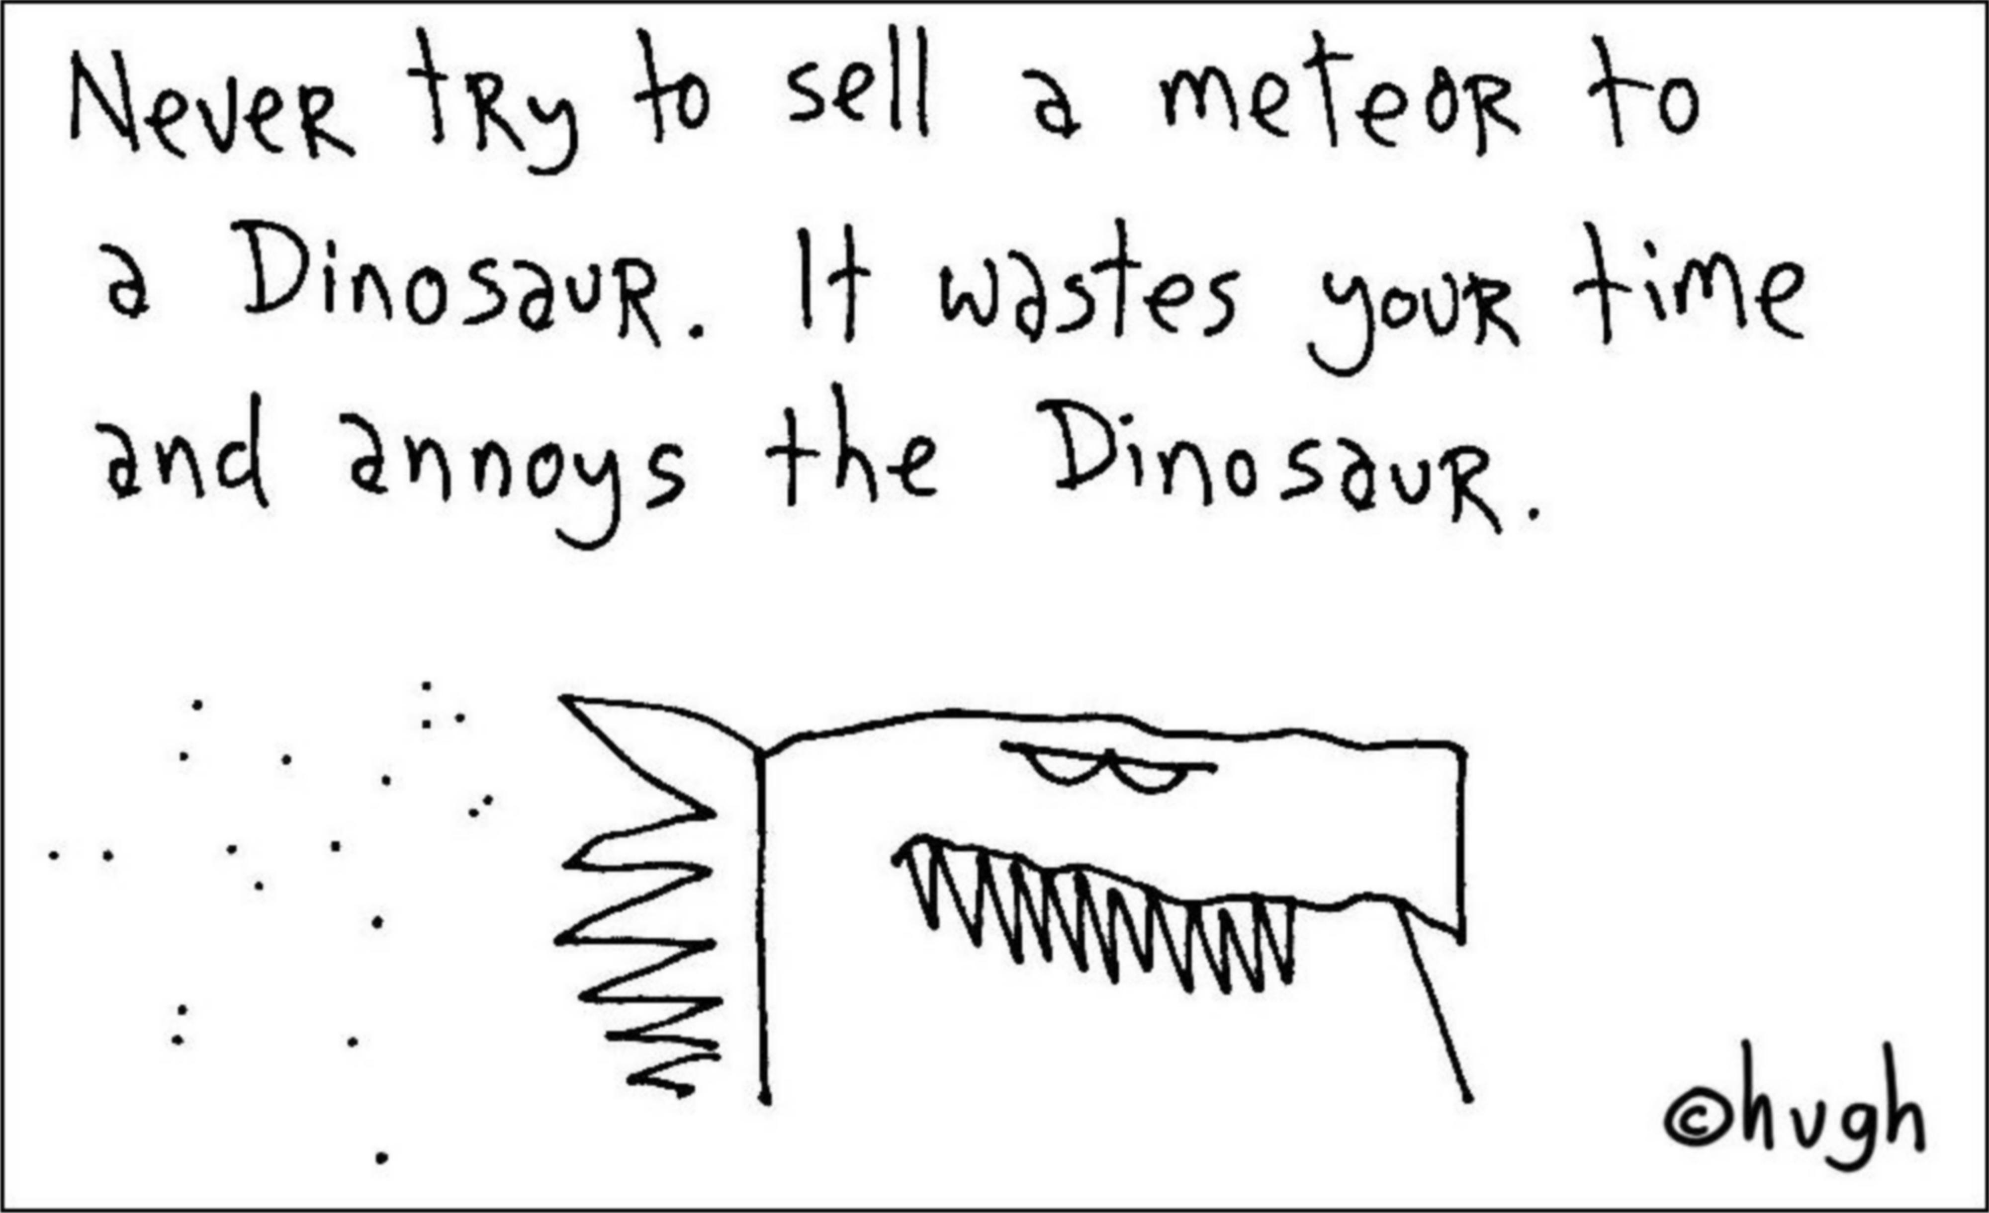
Recommendable
Social Object

Slide 9
Recommendable (cont’d)
You can’t hide!
Good OR Bad – Bed in a Box
Share
Like, Send
Tweet, RT
Check-in, Tip, Shout
Tag in a photo
Post
email
SMS, Phone, IM . . . smoke signals

Slide 10
Recommendable (cont’d)
Brand Experience
You don’t own it!
Twitter
65% / 59%
Mobile Optimized
Pages -> Sites
Post-PC Era
Gamification

Slide 11
Transparent
Reputation Economy
Human voice
Dialog vs. Broadcast
Be honest but . . .
Don’t share IP
Don’t get too personal
If it doesn’t feel right; don’t do it!
Examples
Sony
Microsoft
Google & Apple

Slide 12
Collaborative
Prosumers or Peer Production
Icelantic Skis
First Tracks
Retreat
Monthly corporate call
Vote on artwork
Members interviewed employees and then sent out the interview to the other member
Members only site
Price of admission = Discount

Slide 13
Collaborative (cont’d)

Slide 14
Social Media vs. Social Business
What’s the difference?

Slide 15
Questions?
Michael Myers
michael.myers@du.edu
http://cruc.es

